Slide 1
PROJECT TITLE Secure data hiding in images using steganography
AICTE PROJECT
Presented By:
Student Name : RASHMI KUMARI
College Name & Department : IGNOU, MCA_NEW

Slide 2
OUTLINE
Problem Statement
Technology used
Wow factor
End users
Result
Conclusion
Git-hub Link
Future scope

Slide 3
Problem Statement
With the increasing need for secure communication, protecting sensitive data from unauthorized access is essential.
Steganography offers a technique to hide information within digital images, ensuring confidentiality without drawing suspicion.
This project aims to develop a secure and efficient data-hiding method that embeds secret messages in images while preserving their quality.
The objective is to enhance security, prevent detection, and enable reliable data extraction without noticeable image distortion.

Slide 4
Technology used
Programming Languages: Python(for implementing steganographic algorithms).
Steganography Techniques: LSB (Least Significant Bit), DCT (Discrete Cosine Transform), DWT (Discrete Wavelet Transform), or Adaptive Steganography.
Image Processing Libraries: OpenCV
Cryptography: AES (Advanced Encryption Standard) or other encryption techniques for added security.
Github to Push the Project code for storing it for future reference.

Slide 5
Wow factors
Multi-layer Embedding: Store data across multiple image layers for better robustness.
AES or RSA Encryption: Encrypt the hidden message before embedding for double-layer security.
Interactive GUI: A sleek, easy-to-use interface with real-time previews.
Multiple File Format Support: Work with PNG, JPEG, BMP, etc.
Cloud Integration: Store and retrieve steganographic images securely from the cloud.

Slide 6
End users
🔐 Cybersecurity Professionals
To securely transmit sensitive data without attracting attention.
🏢 Government & Intelligence Agencies
For confidential communication and secure data exchange.
💼 Corporate Organizations
To protect trade secrets, sensitive documents, and intellectual property.
📧 Journalists & Whistleblowers
To safely share critical information without exposure.
📱 General Users & Privacy Enthusiasts
To protect personal data, private messages, and confidential files.
🎮 Gaming & Digital Watermarking Industry
For copyright protection and secure digital rights management.

Slide 7
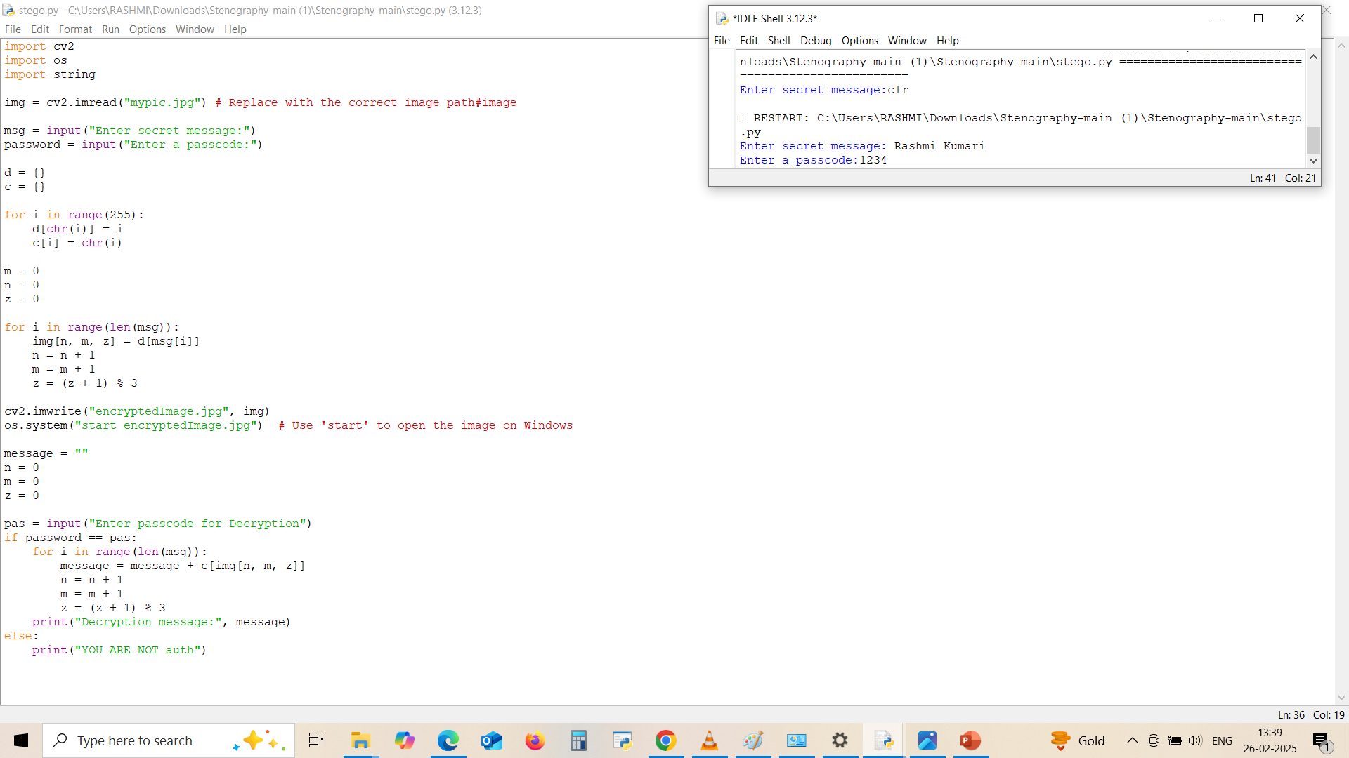
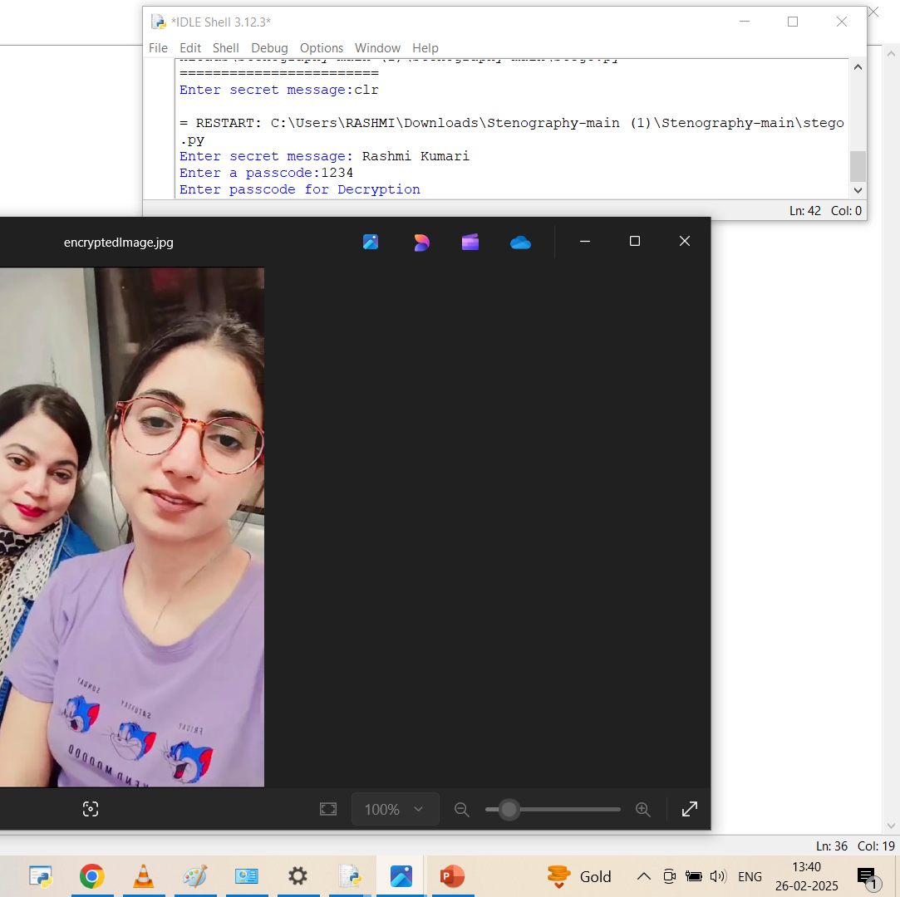
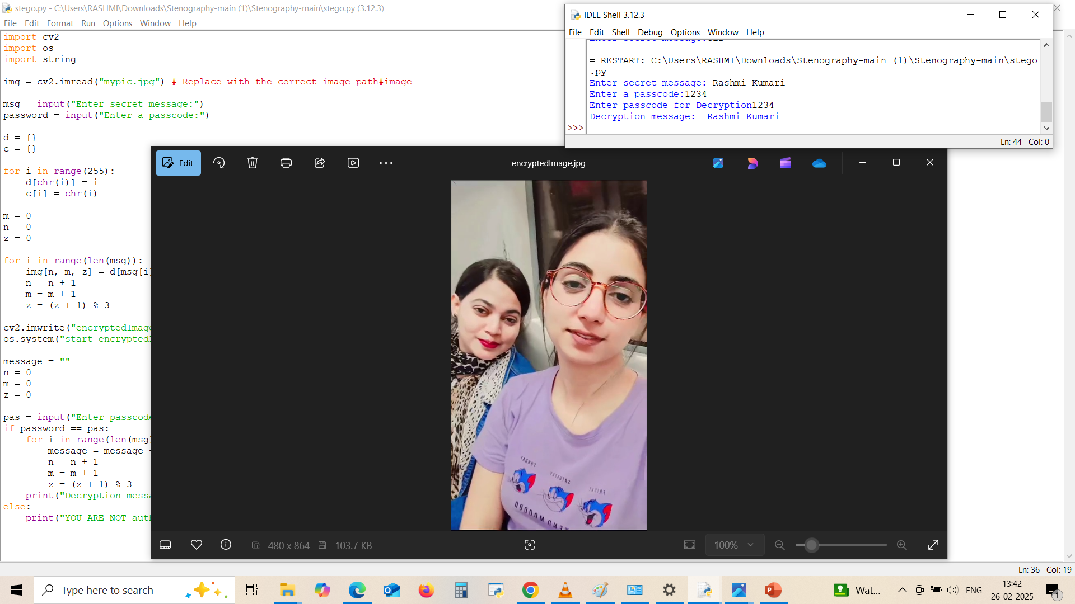
Results
Screenshots of the outcome (min 3)

Slide 8
Conclusion
This project successfully implements a secure data-hiding technique using steganography to ensure confidential communication.
By embedding sensitive information within digital images, it enhances data security while maintaining theimage's visual integrity.
The use of advanced steganographic methods and encryption ensures robustness against detection and unauthorized access.
This approach provides a reliable solution for secure data transmission in various applications, including cybersecurity, corporate
security, and personal privacy.
Future enhancements may include AI-driven steganalysis resistance and real-time mobile integration for broader usability.

Slide 9
GitHub Link
https://github.com/Razzmee/Steganography_AICTE.Project.git

Slide 10
Future scope(optional)
🔹 🔒 Enhanced Security Features
Implement AI-driven adaptive steganography to intelligently hide data based on image complexity.
Use blockchain technology for secure tracking and verification of hidden data.
🔹 📱 Mobile & Cloud Integration
Develop a mobile app for secure steganographic messaging.
Integrate cloud storage for encrypted steganographic image sharing.
🔹 🤖 AI & Machine Learning Integration
Improve detection resistance using deep learning-based steganalysis models.
Use GANs (Generative Adversarial Networks) to create highly undetectable steganographic images.
🔹 🖼️ Multi-Media Steganography
Extend the technique to video, audio, and text-based steganography for broader applications.
Implement real-time steganography in live video streams for secure communication.
🔹 ⚡ Performance & Efficiency Improvements
Optimize compression algorithms to reduce file size while maintaining security.
Implement faster encoding/decoding methods to handle large datasets efficiently.

Slide 11
THANK YOU

